Slide 1
Lecture 10 CUDA Instructions
Kyu Ho Park
May 2, 2017
Ref:[PCCP]Professional CUDA C Programming

Slide 2
Issues
Applications:
I/O-bound applications
Compute-bound applications
Low-level instruction tuning
double value= a*b + c;//MAD(multiply-add)
This pattern is so common, modern architectures support a MAD instruction that fuses a multiply and an add operation.

Slide 3
MAD instruction
The number of cycles to execute the MAD operation is halved.
The results of a single MAD instruction are often less numerically accurate that with separate multiply and add instructions.

Slide 4
CUDA Instructions
Three topics that significantly affect the instructions generated for a CUDA kernel:
floating point operation
: Affect both accuracy and performance of CUDA programs
intrinsic and standard functions,
: they implement overlapping sets of mathematical operations but offer different accuracy and performance.
atomic instructions
:they guarantee correctness of concurrent operations on
a variable from multiple threads.

Slide 5
Floating-Point Instructions Issues
Accuracy of floating-point arithmetic
Precision of floating-point number representation
Consideration in parallel computation

Slide 6
Floating-Point Format
IEEE floating-point standard:
A numerical value is represented in three groups of bits,
S(sign),E(Exponent) and M(Mantissa).
value=(-1)^{S} x 1.M x {2^{E-bias}}
,where S=0 means a positive number and
S=1 a negative number.
sign | exponent | fraction

Slide 7
32-bit and 64-bit format
float
1 | 8 | 23
double
1 | 11 | 52

Slide 8
Representation of M
value=(-1)^{S} x 1.M x {2^{E-bias}}
Example: a decimal number 0.5, represented by 0.5_{D.}
0.5_{D}=1.0_{B} x 2⁻¹ , therefore M=0.
The numbers that satisfy this restriction is referred to as
normalized numbers. The mantissa of 0.5_{D} in a 2-bit mantissa representation is 00. by omitting 1. from 1.00.

Slide 9
Floating-Point Intructions
float a=3.1415927;
float b=3.1415928;
if(a==b) {
printf(“a is equal to b\n”);
} else {
printf(“a is not equal to b\n”);
}

Slide 10
On architecture compatible with the IEEE754, the output is
“ a is equal to b”.
Floating point values are rounded to representable value.

Slide 11
double a=3.1415927;
double b=3.1415928;
if(a==b) {
printf(“a is equal to b\n”);
} else {
printf(“a is not equal to b\n”);
}

Slide 12
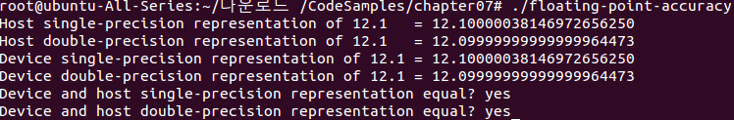
Single and Double Precision

Slide 13
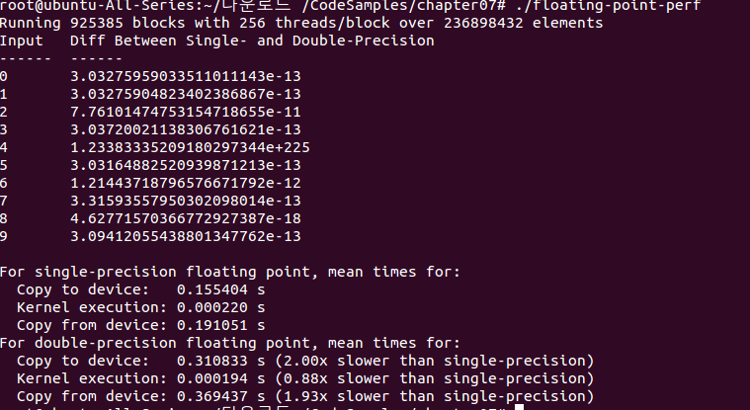
Single and Double Precision

Slide 14
Algorithmic Considerations
Consider 1 bit S, 2 bits M, 2 bits E.
1.00_{B} x2⁰ +1.00_{B} x2⁰ +1.00_{B} x2⁻² +1.00_{B} x2⁻² =?
(((1.00_{B} x2⁰ +1.00_{B} x2⁰ ) +1.00_{B} x2⁻² )
+1.00_{B} x2⁻² )= (1.00_{B} x2¹+ 1.00_{B} x2⁻² )
+1.00_{B} x2⁻² = 1.00_{B} x2¹ + 1.00_{B} x2⁻²
= 1.00_{B} x2¹

Slide 15
Algorithmic Considerations
1.00_{B} x2⁰ +1.00_{B} x2⁰ +1.00_{B} x2⁻² +1.00_{B} x2⁻² =(1.00_{B} x2⁰ +1.00_{B} x2⁰ )+(1.00_{B} x2⁻² +1.00_{B} x2⁻² )
=1.00_{B} x2¹ + 1.00_{B} x2⁻¹ = 1.01_{B} x 2¹

Slide 16
Algorithmic Considerations
A technique to maximize floating point arithmetic accuracy is to sort data before a reduction computation.
Divide the numbers into groups in a parallel algorithm. And use each thread to sequentially reduce values within each group,
Having the numbers sorted in ascending order allows a sequential addition to get higher accuracy.
[Kahan, Further remarks on reducing truncation errors,Communications of ACM,8(1)40.]

Slide 17
Intrinsic and Standard Functions
CUDA arithmetic functions:
Intrinsic functions:
They can be accessed only from device code.
Many trigonometric functions which are directly implemented in hardware on GPUs.
Standard functions:
It includes C standard math library, single- instruction operations like multiplication and addition.

Slide 18
Atomic Instructions
An atomic instructions performs a mathematical operation in a single uninterruptable operation with no interference from other threads.
CUDA provides atomic functions that perform read-modify-write atomic operations on 32-bits or 64-bits of global memory and shared memory.

Slide 19
Atomic Instructions
Each atomic function implements a basic mathematical operation such as addition, multiplication, or subtraction.
Atomic instructions have a defined behavior when operating on a memory location shared by two competing threads.

Slide 20
Atomic Instructions
A kernel:
__global__ void incr(int *ptr){
int temp=*ptr;
temp=temp+1;
*ptr=temp;
}
If a single block of 32 threads were launched running this kernel, what output will it be?

Slide 21
Atomic Instruction
int atomicAdd( int *M, int V);
//the atomic function is executed on V and the value already stored at location, *M and the result is saved to the same memory location.
__global__ void incr(__global__ int *ptr){
int temp=atomicAdd(ptr,1);
}

Slide 22
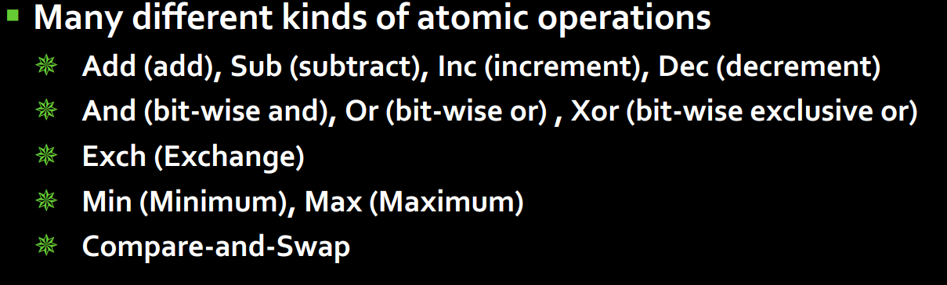
Atomic Operations

